Slide 1



STUDENT PORTAL
MANAGEMENT SYSTEM
Presented by:
Md. Tushar Khan
Md. Minhaz Ahamed Rohan
Md. Ashike Rabby

Slide 2

OVERVIEW
01
02
03
Introduction
Objectives
System Features
04
05
06
Implementation Plan and Outcomes
Final Outcomes
Conclusion
Presented by: 1. Md. Tushar Khan 2. Md. Minhaz Ahamed Rohan 3. Md. Ashike Rabby

Slide 3




INTRODUCTION
The Student Portal Management System is a desktop-based application developed using C++ and the Qt framework, aimed at streamlining student data management in educational institutions. It enables students to securely register, log in, and manage their personal and academic information through an intuitive graphical interface.
The system replaces traditional manual processes with a digital solution that ensures data consistency, security, and accessibility. Core features include secure authentication, profile management, document uploads, and persistent storage using CSV files. This project showcases the practical application of object-oriented programming, GUI design, and file handling in a real-world context.
Presented by: 1. Md. Tushar Khan 2. Md. Minhaz Ahamed Rohan 3. Md. Ashike Rabby

Slide 4

KEY FUNCTIONALITY
Student Info
Login Panel
CGPA calculator
Course Management
Payment
Parking
Presented by: 1. Md. Tushar Khan 2. Md. Minhaz Ahamed Rohan 3. Md. Ashike Rabby

Slide 5





PROBLEM STATEMENT
01
Challenges of traditional student record management
02
Security Concerns
03
Manual errors, Inefficiencies
04
Need for an automated system
Presented by: 1. Md. Tushar Khan 2. Md. Minhaz Ahamed Rohan 3. Md. Ashike Rabby

Slide 6





OBJECTIVES & SYSTEM FEATURES
Student Information Record Dashboard
Excel-based data storage
Secure Login Panel
Automated CGPA calculator
GUI for user-friendly access
Presented by: 1. Md. Tushar Khan 2. Md. Minhaz Ahamed Rohan 3. Md. Ashike Rabby

Slide 7



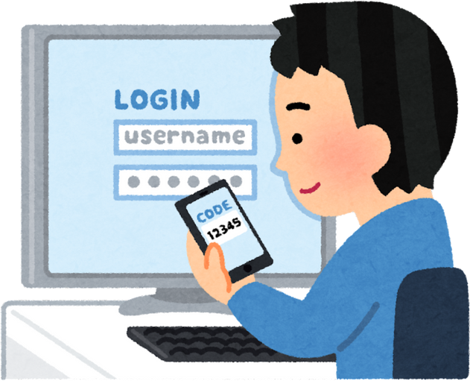


TECHNOLOGY STACK
Programming Language: C++ (OOP principles, STL for data handling)
GUI Framework:
Qt for cross-platform GUI development
Authentication: Secure hashing techniques
Database: CSV/Excel file integration
Presented by: 1. Md. Tushar Khan 2. Md. Minhaz Ahamed Rohan 3. Md. Ashike Rabby

Slide 8

IMPLEMENTATION PLAN
Phase 1:
System Design & Requirement Analysis
Phase 2:
Development
Phase 3:
Testing & Debugging
Phase 4:
Deployment & Maintenance
Presented by: 1. Md. Tushar Khan 2. Md. Minhaz Ahamed Rohan 3. Md. Ashike Rabby

Slide 9



FINAL
OUTCOMES
✅ Secure Student Authentication Implemented a reliable login and signup system with password hashing, ensuring data privacy and protection.
✅ User-Friendly Dashboard Created an intuitive dashboard where students can view and manage their personal and academic details with ease.
✅ Structured Data Storage Successfully integrated CSV-based data handling to store and retrieve user information, enabling persistent and organized
recordkeeping.
✅ Profile Photo & Document Uploads Enabled students to upload their profile images and important documents, enriching the information management system.
✅ Fully Functional GUI with Qt Designed and implemented a responsive and modern GUI using the Qt framework, improving the overall user experience.
✅ Scalable & Modular Codebase Developed with a modular design using object-oriented principles, making the system scalable for future feature additions like course management or fee payment.
✅ Practical Application of Concepts Applied real-world programming skills including file I/O, data validation, and event-driven programming within a professional software development environment.
Presented by: 1. Md. Tushar Khan 2. Md. Minhaz Ahamed Rohan 3. Md. Ashike Rabby

Slide 10


Thank's For Watching!!

